Slide 1
INF10025
Data Management and Analytics
Lecture 7 – Part 2
SQL & Aggregate Functions

Slide 2
Movie Database
Previously we worked with the The Movie Database.
It has Movies, Actors, Casting (plus other tables)
MOVIE ( movieNo, title, relyear, runtime, rating )
ACTOR ( actorNo, firstname, surname, gender)
  CASTING ( movieNo, actorNo)
movieNo | title | relyear | runtime | rating
15 | The Hunger Games | 2012 | 142 | PG
41 | Silver Linings Playbook | 2012 | 122 | MA
135 | The Hangover | 2009 | 100 | MA
156 | X-Men Days of Future Past | 2014 | 101 | PG
actorNo | firstname | surname | gender
89 | Jennifer | Lawrence | F
220 | Bradley | Cooper | M
290 | Scarlett | Johansson | F
422 | Hugh | Jackman | M
actorNo | movieNo
220 | 41
89 | 41
89 | 15

Slide 3
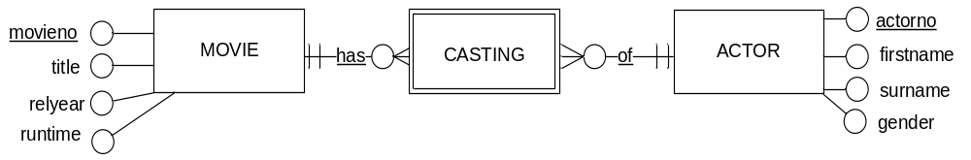
MovieActor Entity
If we 'reverse engineer' the move database, we can create an ERD.
It has many-to-one relationships.
The Identifier of MOVIEACTOR is MovieNo + ActorNo.
CASTING is a WEAK entity.
The two relationship names are underlined
The casting entity has a double outline
The identifier of casting is movieNo + ActorNo
  How do you know this?
  The ERD fully explains this information

Slide 4
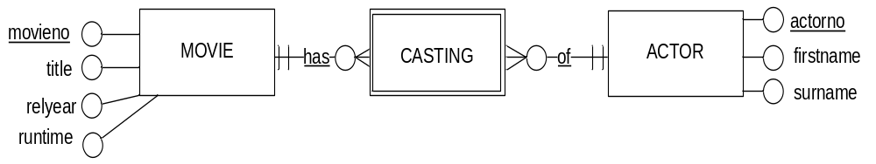
MovieActor / Casting Entity
The naming of weak entities can sometimes be difficult.
  The name 'MovieActor' is not a natural or 'real world' name.
  A more appropriate name might be CASTING
  Wherever possible, try to use the word or term that would be used within the industry/business that you are modeling

Slide 5
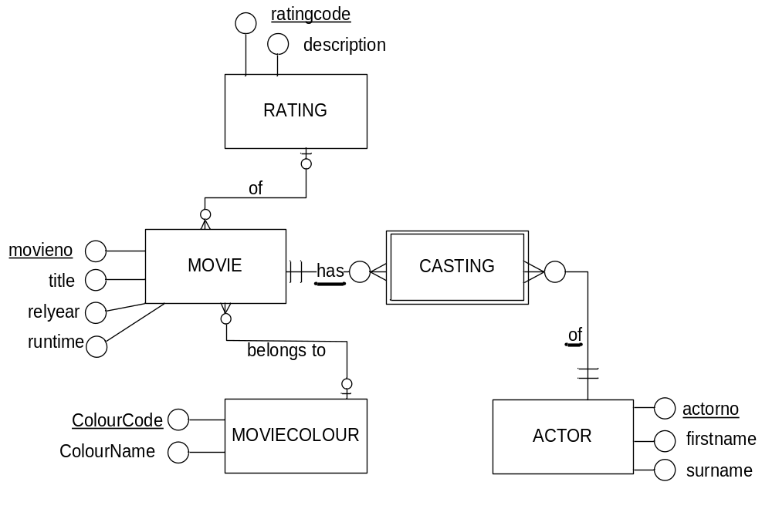
The completed ERD
Answer these questions:
Once the ERD has been converted
to a database schema
Which relations will have FKs?
How many FKs in each relation?

Slide 6
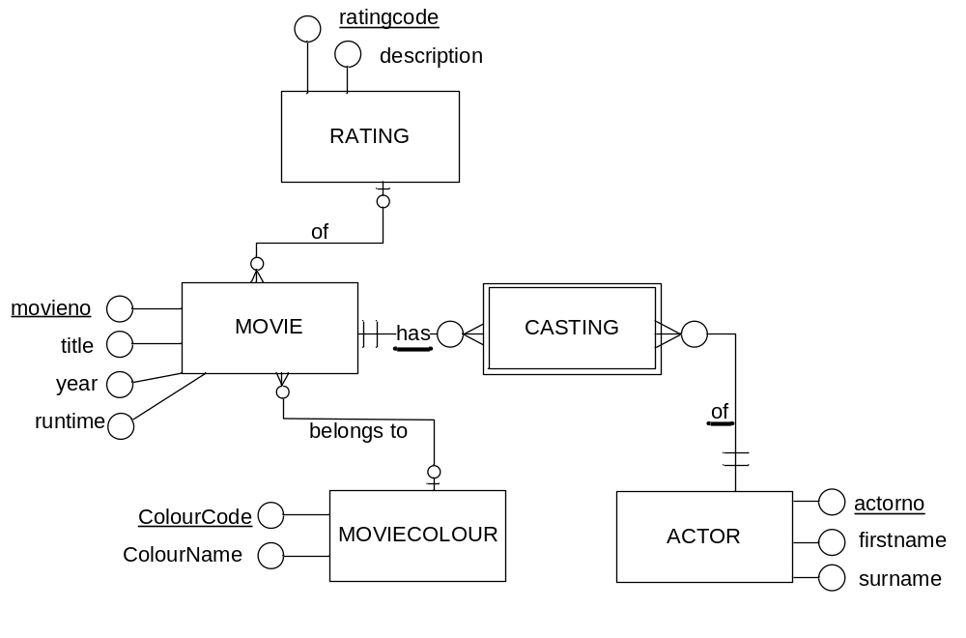
Converting the Movie ERD To RM
MOVIECOLOUR
colourcode | colourname
CASTING
actorno | movieno
RATING
ratingcode | description
ACTOR
actorno | firstname | surname
MOVIE
movieno | title | ratingcode | colourcode | relyear | runtime

Slide 7
Relationships
Each of the following relationships is almost identical
Each deals with a totally different business
Each business has a number of Strong Entities that
interact with each other
This interaction creates a need for Weak Entities

Slide 8
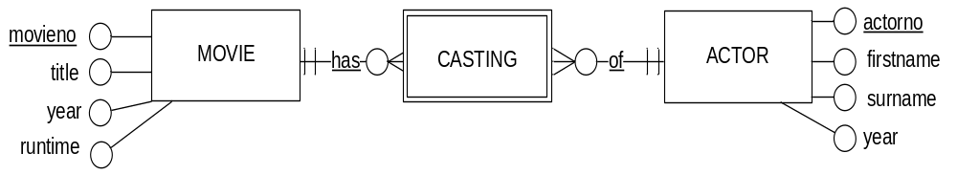
Movies & Actors & Casting
ACTOR
MOVIE
actorNo | firstname | surname
89 | Jennifer | Lawrence
220 | Bradley | Cooper
290 | Scarlett | Johansson
movieNo | title
15 | The Hunger Games
41 | Silver Linings Playbook
135 | The Hangover
MOVIEACTOR
actorNo | movieNo
220 | 41
89 | 41
89 | 15
What is the purpose of the weak entity?
What does it do?

Slide 9
Relationships
What is the purpose of the Casting Entity?
It allocates an instance of Actor to an Instance of Movie
  Ben Stiller is cast in Zoolander
CASTING
actorNo | movieNo
220 | 1
290 | 1
290 | 135

Slide 10
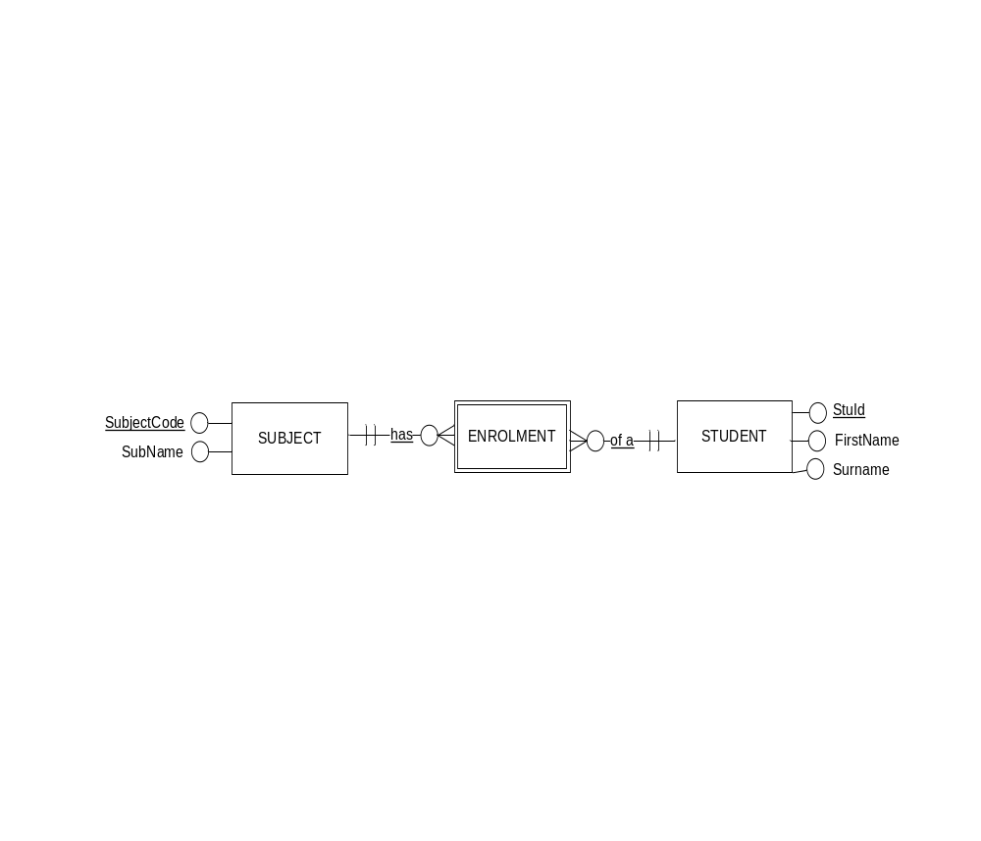
Students, Subjects, Enrolments
Consider enrolments at University.
SUBJECT
STUDENT
subjectcode | subname
HIT1402 | DataBase Analysis…
HIT1404 | Intro to Prog in VB...
HIT2425 | Bus Systems Prog…
stuId | firstname | surname
1122334 | Jane | Taylor
4444555 | Jobe | McKay
7777700 | Helen | Freeman
ENROLMENT
subjectcode | stuId
HIT1402 | 1122334
HIT1404 | 1122334
HIT1402 | 4444555
HIT2425 | 4444555
HIT1402 | 7777700
What is the purpose of the weak entity?
What does it do?

Slide 11
Relationships
What is the purpose of the Enrolment Entity?
It enrols an instance of Student to an Instance of Subject
  Jane Taylor is enrolled in Database Analysis and Design
  Jane Taylor is enrolled in Intro to Programming VB.Net
ENROLMENT
subjectcode | stuId
HIT1402 | 1122334
HIT1404 | 1122334
HIT1402 | 4444555

Slide 12
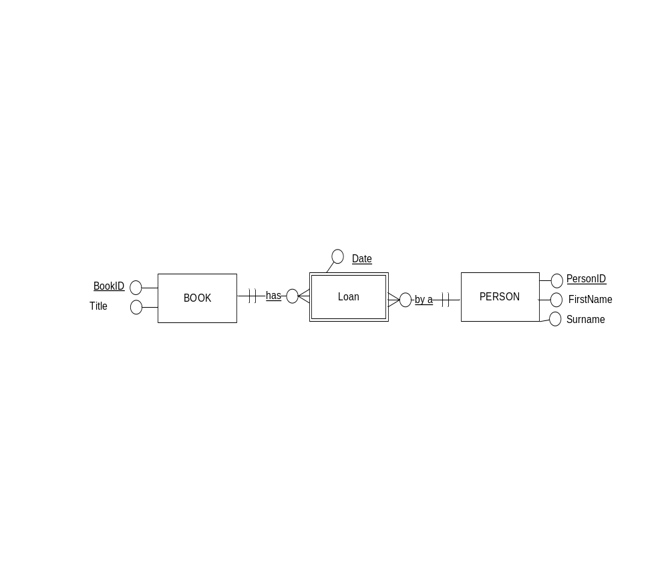
Books, Persons, Loans
Consider book loans
BOOK
PERSON
BookID | Title
111111 | How to Program
222222 | Marketing 101
333333 | Book of Quotes
PersonID | firstname | surname
1005 | Lou | James
8009 | Jim | Carver
1305 | Peter | Brown
LOAN
BookID | PersonID | Date
111111 | 1005 | 1 May
222222 | 1005 | 1 May
333333 | 8009 | 2 May
111111 | 1005 | 13 Jun
What is the purpose of the weak entity?
What does it do?

Slide 13
Relationships
What is the purpose of the Loan Entity?
It records a loan of a Book to a Person
  Lou James borrowed How to Program on 1 May
  Lou James borrowed Marketing 101 on 1 May
  Lou James borrowed How to Program on 13 June
LOAN
BookID | PersonID | Date
111111 | 1005 | 1 May
222222 | 1005 | 1 May
333333 | 8009 | 2 May
111111 | 1005 | 13 Jun

Slide 14
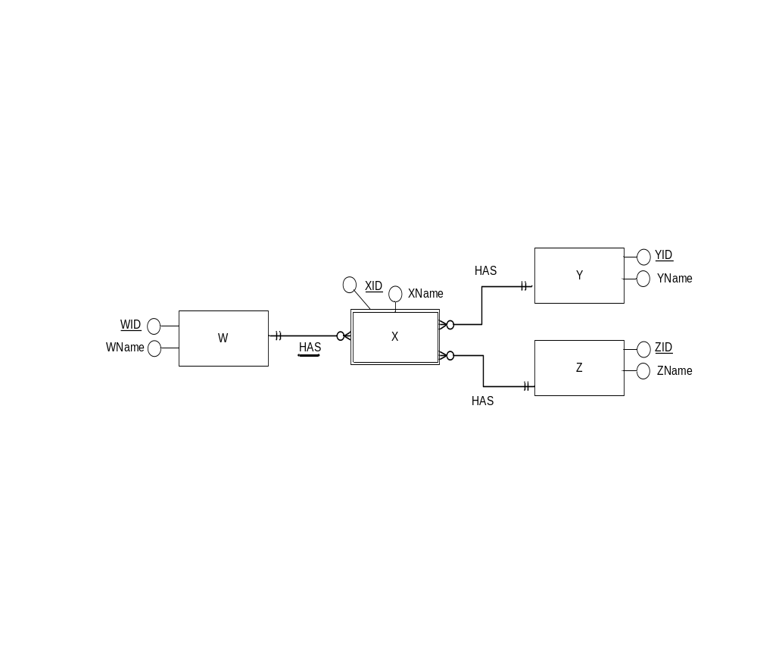
Relationships
What is the Identifier of entity X?
XID + WID + YID + ZID
XID + WID + YID
XID + WID
XID

Slide 15
Relationships
Weak entities borrow the identifier from the entity on the other end of any relationship line that is underlined.
X (WID, XID, XNAME, YID, ZID)
PK (WID, XID)
FK (WID) References W
FK (YID) References Y
FK (ZID) References Z

Slide 16
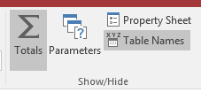
SQL Aggregate Functions
Previously, you have used Aggregate functions
  Called "Totals" in MS Access.
These used functions such as Count, Sum, Min, Max …
Each function is applied over a number of rows at one time
The usual SELECT statement clauses such as WHERE and ORDER BY can be used in the same way

Slide 17
SQL COUNT() Function
COUNT(*) is an example of an aggregate function
  It counts the number of rows
  Use a * with this statement to count ALL rows
  Use a <column-name> with this statement to count ALL rows that do not contain a NULL value in that column
SELECT COUNT(*)
FROM movie
SELECT COUNT(ratingcode)
FROM movie
COUNT(*)
384
COUNT(ratingcode)
381
Three movies have a NULL ratingcode
If ratingcode does not contain Nulls, both statements produce identical results

Slide 18
SQL Aggregate Functions
The Select clause still has all the usual clauses available.
These examples use a WHERE clause
Only rows that meet the condition are Counted
SELECT COUNT(*)
FROM movie
WHERE relyear = 2004;
COUNT(*)
19
SELECT COUNT(*)
FROM movie
WHERE relyear >= 2000
AND relyear <= 2009;
COUNT(*)
117

Slide 19
SQL Aggregate Functions
This is a list of the most widely used aggregate functions
In each case the function is applied over a number of rows
  • Sum • Count • Avg • Min • Max
When using Sum, Avg, Min & Max you must specify a column name
SELECT SUM( run_time ) FROM movie ;
SELECT AVG( run_time ) FROM movie;
SELECT MIN( run_time ) FROM movie ;
SELECT MAX( run_time ) FROM movie ;
SELECT SUM( runtime ) FROM movie WHERE UPPER(title) = 'HAMLET';
SELECT MIN( run_time ) FROM movie WHERE year = 2005;

Slide 20
SQL Round Function
When dealing with averages or when dividing numbers, results often contain a large number of digits after the decimal place
The Round() function is useful in this situation.
    Syntax:
    ROUND ( number, [ decimal_places ] )
If the number of decimal places is omitted, then the round function will
round the number to 0 decimal places.
AVG(RUNTIME)
121.5094339622641509433
SELECT AVG( runtime ) FROM movie
ROUND(AVG(RUNTIME),2)
121.51
SELECT ROUND( AVG (runtime ), 2) FROM movie
SELECT ROUND( AVG (runtime ) ) AS "AVG_RUNTIME"
FROM movie
AVG_RUNTIME
122

Slide 21
SQL Aggregate vs Non-aggregate
Items listed in the Select Clause of a SELECT statement
are generally either
  Non-aggregate expressions (Typically columns names)
    TITLE
    RUNTIME
    RELYEAR
    MOVIENO…
  SQL Aggregate expressions:
    AVG(RUNTIME)
    MIN(RELYEAR)
    SUM(RUNTIME)
    COUNT(*)…

